Slide 1
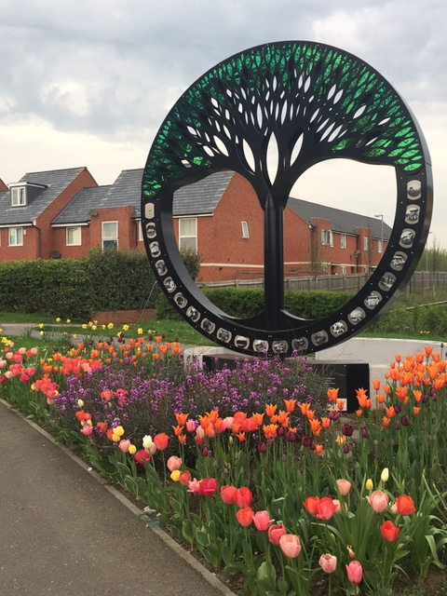
Community, Health and Wellbeing strategy for
Duston 2024 - 2027
Add image here
Adopted 07/03/2024 – V1

Slide 2
Add image here
Duston Parish Council is passionate about delivering for the residents of Duston. We believe that by having a Community, Health and Wellbeing strategy we can lead and support the myriad of active groups in our community so that we are all working towards the common aim of a ‘Duston Together’

Slide 3
Why ? What ? How ?
Why do we want this?
What are our priorities?
How do we
achieve them?
CONSOLIDATES :
RESOURCES :
Duston Together
Community Events
Community Groups & Organisations
Duston Good Neighbours
DOPWA
Environmental Responsibility
PARTNERS & SUPPORT:
LAPs data
Evaluation data from events & initiatives
Duston local insight data
Action for Happiness
The role of Parish & Town Councils in Health and Wellbeing by Sadie Beishon
Resident surveys
Local schools
Local businesses
Local care homes
Local healthcare services
Churches
Trilogy
Local community
Duston library

Slide 4
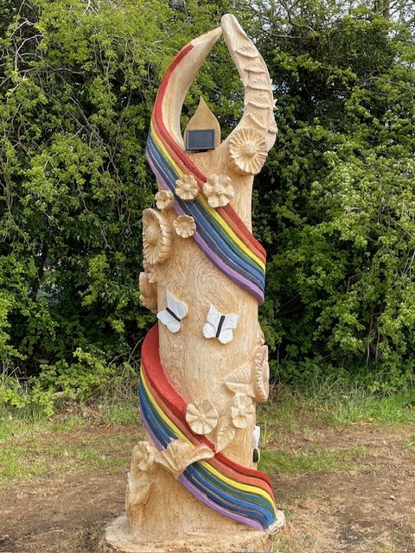
Our Mission
Our mission is to establish a framework that will enable Duston Parish Council to lead and support a collective desire to help improve the health and wellbeing of its residents and the area in which they live.
A wide variety of proactive groups and organisations already exist within Duston, and a strong sense of community spirit is evident amongst our local population. By working together effectively and consolidating all that is positive we are stronger as a community.
This also allows us to achieve much more as a collective in our aim to enrich
our community and the lives of those who live here.
Add image here

Slide 5
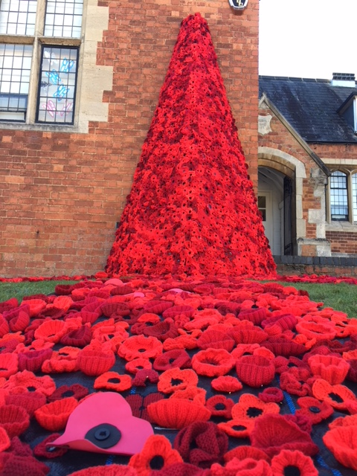
Our Strategy
Good Community, Health and Wellbeing takes many forms:
Anything that can improve things even slightly can have a significant impact. Harnessing best practices and taking preventative action can help us improve many aspects of daily
life including socially, environmentally, physically and mentally.
We can strengthen relationships by working in partnership with our local schools, businesses, care homes, healthcare services, churches, sports and community groups.
In addition, we will continuously monitor and evaluate our initiatives to assess the positive outcomes and ensure their continued relevance and effectiveness.
As a Parish Council we recognise the value and importance of doing everything within our power to help improve our community and the health and wellbeing of its residents.
We believe that we have a role to play in contributing to this by consciously and deliberately putting Community, Health & Wellbeing at the heart of all that we do.
By adopting this strategy, we can ensure that our aims and objectives are sustained throughout time and that what we do remains relevant and adaptive to the changing needs of our community
Add image here

Slide 6
Our Three Priorities
1
To ensure that we offer a considered variety of pertinent activities, opportunities and improvements across all sectors, ages and demographic to help improve the community and the health and wellbeing of our residents.
2
To always utilise the latest resources and data insights available to ensure that what we
do is focused and inclusive and that the decisions we make are relevant to the needs of
our community.
3
To ensure that our programme, projects and activities align with and support the Integrated Care Northamptonshire’s (ICN) ‘Live your Best Life’ ambitions.

Slide 7
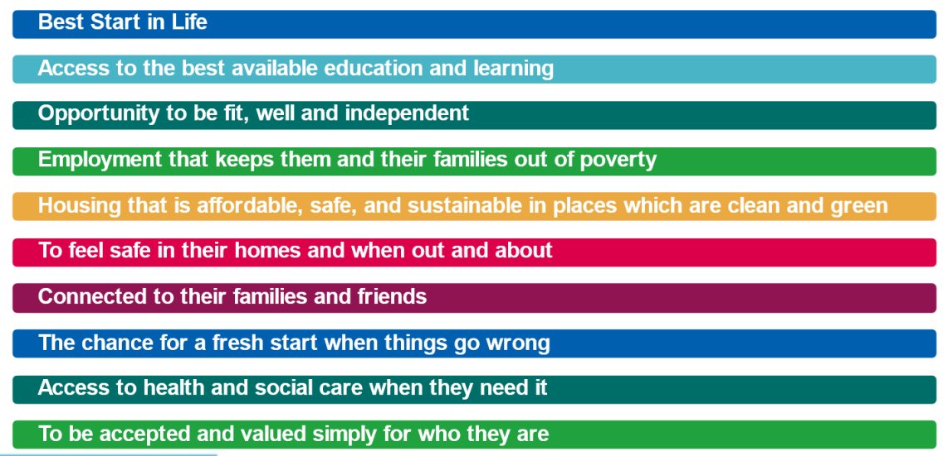
ICN ‘Live Your Best Life’ ambitions

Slide 8
How Duston Parish Council currently supports Integrated
Care Northamptonshire 'Live your best life’ ambitions
Ambition and outcome | How do we currently align / support
. | Across ALL 10 ambitions: Provide centralised info on other relevant groups operating in Duston that support the ICN strategy Provide centralised info about the programmes at Duston Sports Centre that support the ICN strategy Promote community groups and activities operating in Duston Support the current Library programme and develop new groups and activities by working together
BEST START IN LIFE - Women are healthy and well during and after pregnancy. Children grow and develop well so they are ready and equipped to start school | Two large nursery provisions operate from DPC centres
2. ACCESS TO THE BEST AVAILABLE EDUCATION AND LEARNING – Education settings are good and inclusive and children and young people, including those with special needs, perform well. Adults have access to learning opportunities which support them with work and life skills | Wellbeing talks offer advice and education on a wealth of subjects Support schools and youth organisations via DPC grants DPC liaison with schools and youth organisations to support badgework Allotment space provides opportunities to pre- schools, schools, groups and individuals (including those with learning difficulties) TGTA provides volunteer opportunities DPC Youth provision - varied activities including DJ and gaming
Add image here
Last updated MAY 2024

Slide 9
How Duston Parish Council currently supports Integrated
Care Northamptonshire 'Live your best life’ ambitions
Ambition and outcome | How do we currently align / support
3. OPPORTUNIT Y TO BE FIT, WELL AND INDEPENDENT - Children and adults are healthy and active and enjoy good mental health. People experience less ill health and disability attributed to lung and heart diseases. | Duston Sports Centre programme and Health Walks (Owned by DPC) Public play equipment for young people Outdoor exercise equipment installed at two parks Good upkeep of our local parks and open spaces Relevant equipment installed in parks for all ages including MUGAs The Grow Together Allotment The Grow Cook Eat Project Support of Food Bank & Wellbeing Cafe Monthly Wellbeing Talks Community Info & Wellness Fair Signposting to external services & organisations
4. EMPLOYMENT THAT KEEPS THEM AND THEIR FAMILIES OUT OF POVERTY - more adults are employed and earn a ‘living wage’. Adults and families take up benefits that they are entitled to. | Lease of 8 office units/areas to commercial tenants DPC employs 10 staff Promotes WNC, SIP and Housing Association sessions Supports Food Bank with donation collection points
5. HOUSING THAT IS AFFORDABLE, SAFE AND SUSTAINABLE IN PLACES WHICH ARE GREEN AND CLEAN - the local environment is clean and green with lower carbon emissions. | Maintenance of open green spaces and parks DPC planning committee observations DPC Environment Committee plans DPC is taking on public open spaces & the management of. DPC Neighbourhood Plan to 2029 Bins, anti-dog fouling signs installed regularly Tree and Bulb planting initiatives Purchase of no parking signs for schools
Add image here
Last updated MAY 2024

Slide 10
How Duston Parish Council currently supports Integrated
Care Northamptonshire 'Live your best life’ ambitions
Ambition and outcome | How do we currently align / support
6. TO FEEL SAFE IN THEIR HOMES AND WHEN OUT AND ABOUT - People are safe in their homes, on public transport and in public places. Children and young people are safe and protected from harm. | DPC works with local policing team to exchange feedback from the community 'Design out crime' approach to public spaces Police team invited to report at our meetings Police team invited to attend our events 4 speed activated signs around Duston CCTV provision under regular review DPC have installed 5 defibrillators and 1 bleed cabinet
7. CONNECTED TO THEIR FAMILIES AND FRIENDS - People feel well connected to family, friends and their community. Connections are helped by transport and technology. | Events I Initiatives I TGTA - allow inclusion, reduced social isolation & loneliness, promotes friendship Two community centres offer meeting spaces, opportunity to join activities, develop skills and feel connected Volunteer opportunities to support and also create value and satisfaction Subsidised room hire available for local groups Working with local partners to ensure we always offer as many social opportunities as possible Mailing list alerts of all our events and initiatives Schools/businesses/youth organisations receive monthly activity updates Grants available to support local groups and causes
8. THE CHANCE FOR A FRESH START WHEN THINGS GO WRONG – people have good access to support. | DPC has adopted an Equality & Diversity statement Last updated MAY 2024
Add image here

Slide 11
How Duston Parish Council currently supports Integrated
Care Northamptonshire 'Live your best life’ ambitions
Ambition and outcome | How do we currently align / support
9. ACCESS TO HEALTH AND SOCIAL CARE WHEN THEY NEED IT - People can access NHS services, personal and social care when they need to. People are supported to live at home for as long as possible. Services to prevent illnesses (e.g. health checks, screening and vaccines) are good and easy to access. | WB Talks+ events Care organisations that operate from our centres(Favel Day Services, Affinity Day care) Signposting to local services at our wellness events Further signposting at our wellbeing talks and hubs Use of our centres for NHS Bloods, screening and health checks Working closely with the Supporting Independence Programme service Trilogy offer a personalised health and fitness programme via the patient referral scheme in partnership with St Luke's Surgery
10. TO BE ACCEPTED AND VALUED SIMPLY FOR WHO THEY ARE - People are treated with dignity and respect, especially at times of greatest need like at the end of their lives. Diversity is celebrated. People feel they are a valuable part of their community and not isolated or lonely. | All events and initiatives have a broad and inclusive reach across all demographics, ages etc Provide warm and welcoming spaces within our 3 centres
Add image here
Last updated MAY 2024

